Slide 1


PANIMALAR ENGINEERING COLLEGE Department of Computer Science and Engineering
Third Project Review
DRUG DISCOVERY
Domain:
(Machine Learning)
Project Guide:
A.KARTHIKEYAN
Team Members:
S. YATHIN (2017PECCS287)
K. SATHIYAN (2017PECCS262)
P. SANTHOSH (2017PECCS256)

Slide 2
Introduction
A great variety of experimental data, at a chemical, transcriptomic, or genomic-level is available to readily use for drug development.
Summarizing the huge amount of biological data at hand into meaningful models, to grasp the full mechanism of diseases, seems harder and harder.
However, systems biology and machine learning approaches are continuously enhanced in order to accelerate the path to efficient drug development.
We will focus on three significant related and intermingled questions, that can be subject to automation: drug discovery, drug testing, and drug repurposing.

Slide 3
Firstly, this review briefly dwells on the current context in drug development.
Later, we will review generic machine learning algorithms, and more specifically, we will focus on sequential learning algorithms and recommender systems.
These algorithms have also proven themselves useful in other research fields, and are active biomedical fields of research.

Slide 4
Literature Survey
S.No | Journal Details | Technique Used | Inference
1 | Application of Machine learning in Drug Discovery. Nature reviews drug discovery. | Machine Learning | Drug discovery and development pipelines are long, complex and depend on numerous factors. Machine learning (ML) approaches provide a set of tools that can improve discovery and decision making for well-specified questions with abundant, high-quality data. Opportunities to apply ML occur in all stages of drug discovery. Examples include target validation, identification of prognostic biomarkers and analysis of digital pathology data in clinical trials. Applications have ranged in context and methodology, with some approaches yielding accurate predictions and insights.
2 | Drug Discovery and Drug Identification using AI. Risab Biswas, Avirup Basu, Abhishek Nandy, Arkaprova Deb. | Artificial Intelligence | The paper deals with identifying and creating new drugs using AI technique. We are implementing a process using Intel Open VINO toolkit for identification of drugs. With this detection technique we can identify the reactants which are added as drugs and automates the entire flow.

Slide 5
3 | Assemblable project formulation for drug target discovery “IEEE International Conference on Bioinformatics and Biomedicine Workshops” | Machine Learning | An ever increasing hardness of drug approval processes and criteria leads to a systemic approach to novel target identification and validation. This involves a variety of methods, tools, and related data which collectively pre-validate a drug target in multiple aspects so that it can finally be approved as a new drug. Thus, a key to success of novel drug targets is to establish a target production framework in which heterogeneous methodologies work in concert with one another.
4 | Automating antivirals “ Megan Scudellari” | Artificial Intelligence | Gaston-Mathé runs a startup that applies automated software to the design of new drug candidates. Collins leads a team that uses an automated chemistry platform to synthesize new drug candidates. · “There was an obvious synergy between their technology and ours,” recalls Gaston-Mathé, CEO and cofounder of Paris-based Iktos. · In late 2019, the pair launched a project to create a brand-new antiviral drug that would block a specific protein exploited by influenza viruses.

Slide 6
Objective
At present, There are many diseases in the world for which the vaccine or the drug to cure those disease is not found and also for a new diseases which can come in future it takes Time and more Capital to find a cure for these diseases.
The concept of DRUG DISCOVERY benefits the society, particularly the aging society in a very significant manner.
The general meaning of Drug Discovery is the process underpins the entire pharmaceutical industry, encompassing the early stages of research from target discover and validation, right through to the identification of a drug candidate or lead compound.

Slide 7
Existing System
The advancements of information technology and related processing techniques have created a fertile base for progress in many scientific fields and industries.
In the fields of drug discovery and development, machine learning techniques have been used for the development of novel drug candidates.
The methods for designing drug targets and novel drug discovery now routinely combine machine learning and deep learning algorithms to enhance the efficiency, efficacy, and quality of developed outputs.
The use of these virtual screening and encompassing online information has also been highlighted in developing lead synthesis pathways.

Slide 8
Proposed System
Drug discovery and development pipelines are long, complex and depend on numerous factors.
Machine learning (ML) approaches provide a set of tools that can improve discovery and decision making for well-specified questions with abundant, high-quality data.
Opportunities to apply ML occur in all stages of drug discovery.
The challenges of applying ML lie primarily with the lack of interpretability and repeatability of ML-generated results, which may limit their application.
In all areas, systematic and comprehensive high-dimensional data still need to be generated.

Slide 9
TECHNOLOGY STACK
Machine learning (ML) is the study of computer algorithms that improve automatically through experience and by the use of data. It is seen as a part of artificial intelligence. Machine learning algorithms build a model based on sample data, known as "training data", in order to make predictions or decisions without being explicitly programmed to do so.
Machine learning algorithms are classified into four categories:
1. Supervised learning,
2. Un-supervised learning,
3. Semi-supervised learning,
4. Reinforcement learning.

Slide 10
DEVELOPMENT ENVIRONMENT
HARWARE REQUIREMENTS
Processor : Intel Pentium Dual Core 2.00GHz
Hard disk : 500 GB
RAM : 8 GB (minimum)
SOFTWARE REQUIREMENTS
Python 3.6.4 Version
Anaconda

Slide 11
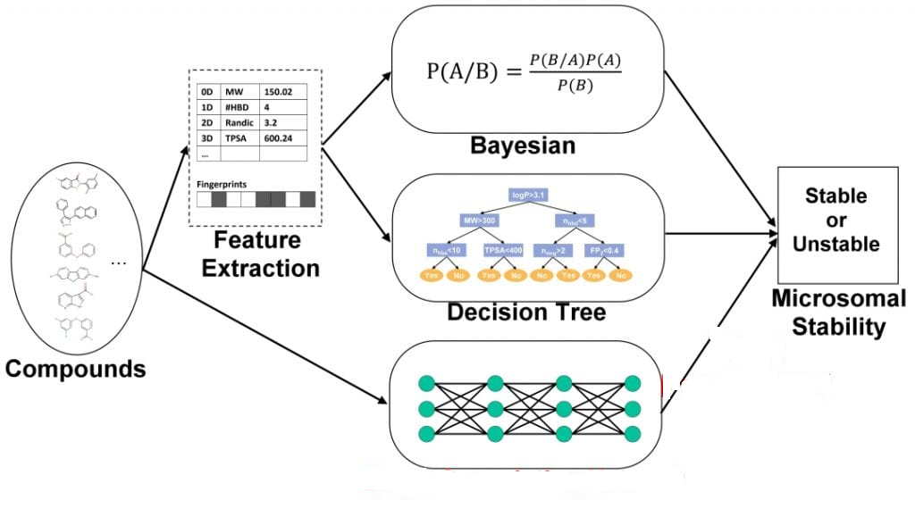
SYSTEM ARCHITECTURE

Slide 12
Anaconda: Anaconda is a free and open source distribution of the Python and R programming languages for data science and machine learning related applications.
Bayesian networks: Bayesian networks are a type of probabilistic graphical model comprised of nodes and directed edges.
Microsomal stability: The results showed that in vitro Phase I microsomal stability t(1/2) is significantly correlated to in vivo clearance with a p-value<0.001. For compounds with low in vitro rat microsomal stability (t(1/2)<15 min), 87% showed high clearance in vivo (CL>25 mL/min/kg).
Feature Extraction: Feature extraction involves reducing the number of resources required to describe a large set of data. When performing analysis of complex data one of the major problems stems from the number of variables involved.

Slide 13
System Design

Slide 14
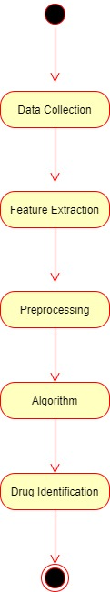
Activity Diagram

Slide 15
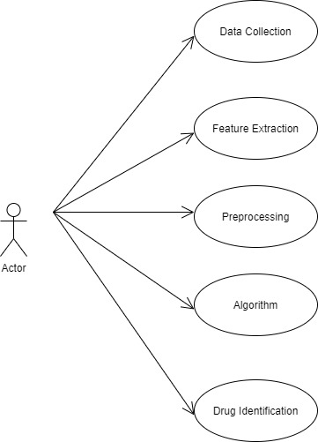
Use Case Diagram

Slide 16
MODULE DESCRIPTION
Dataset
SMILES Representation of Molecules
Model

Slide 17
DATASET
A dataset containing drug molecules (encoded as SMILES) and their binding affinities.
The task is to use this dataset to make a regression model for binding affinity prediction.
The protein functions can be stopped by introducing drug molecules that are capable of blocking the protein.
In other words, preparation of a drug involves finding molecules that can effectively bind to the protein i.e. have a high binding affinity.
The data has been generated using Protein-Ligand docking

Slide 18
SMILES Representation of Molecules
SMILES are character strings to represent drug molecules. For example, carbon atom can be represented as “C”, an oxygen atom can be represented as “O”, double bond by “=”. The molecule Carbon dioxide is represented as “C(=O)=O”.
SMILES | NAME
CC | ethane
O=C=O | Carbon dioxide
C#N | Hydrogen cyanide
CCN(CC)CC | Acetic acid
[OH3+] | Hydronium ion

Slide 19
Model
We load trained mol2vec which is trained on Morgan fingerprints with radius = 1 to yield 300 dimensional embeddings. Link to load trained mol2vec.
Morgan Fingerprints: The Morgan fingerprint is basically a reimplementation of the extended connectivity fingerprint (ECFP).
Mol2vec: Mol2vec is an unsupervised machine learning approach to learn vector representations of molecular substructures.

Slide 20
ALGORITHM
We split the data into train and validate and analyze with various different regression algorithms like Ridge, Support Vector Machine(SVM), Least Absolute Shrinkage and Selection Algorithm(LASSO), etc. and also with their different parameters.

Slide 21
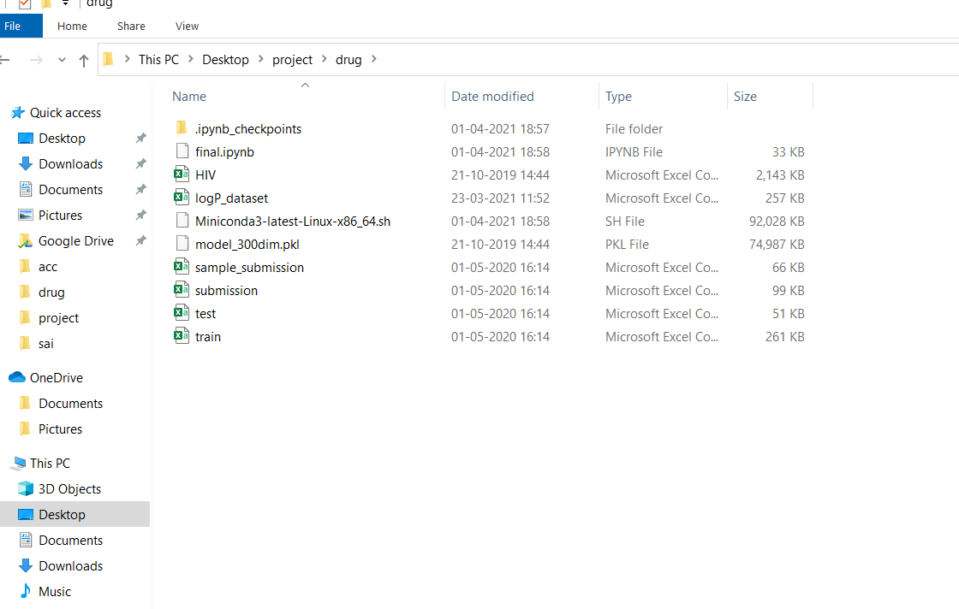
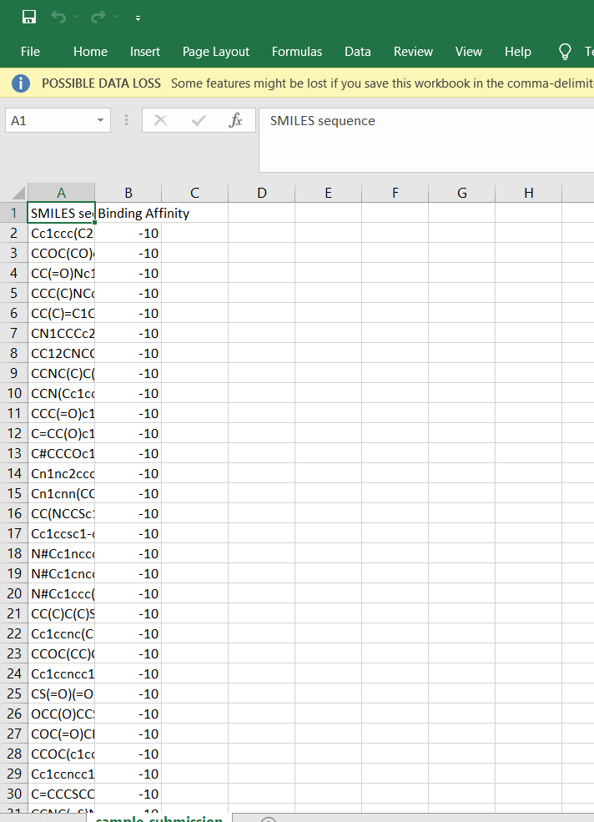
Screenshots

Slide 22
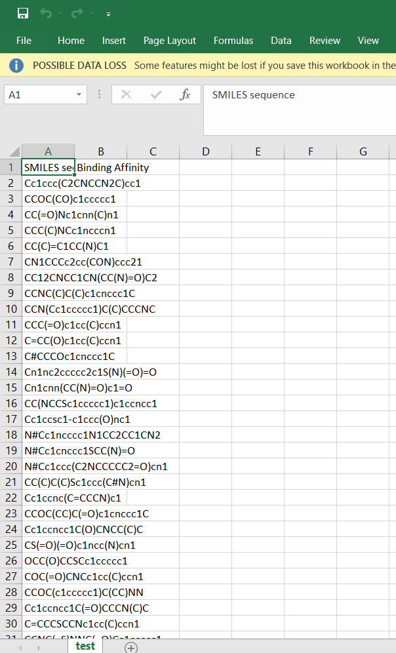
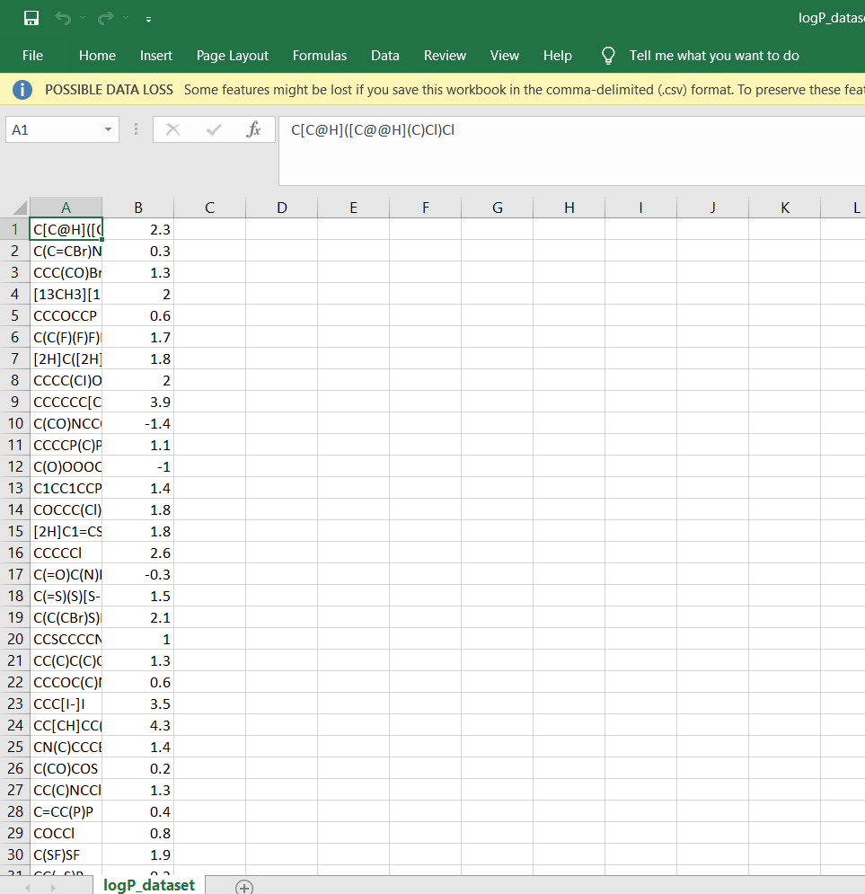

Slide 23
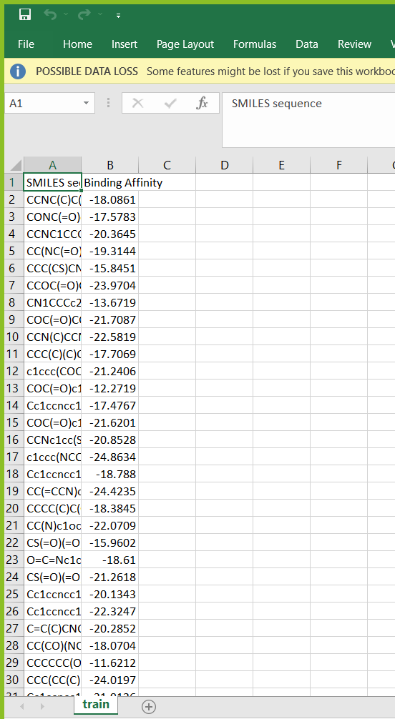
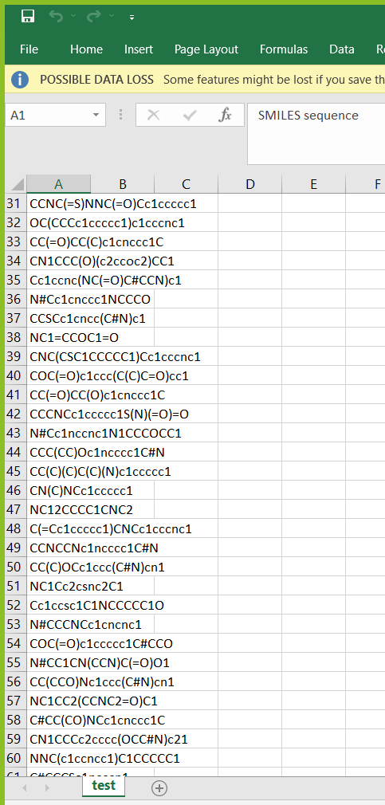

Slide 24
CONCLUSION
ML-based techniques seek to revitalize the development of drugs. These methods are based on separate applications in target discovery, lead compound discovery, synthesis, protein-ligand interactions, etc. ML applications are paving the way for algorithm-enhanced data query, analysis, and generation. One such example is ML incorporated into target discovery, based heavily on the refinement and search of existing omics and medical data. Owing to more precise algorithms, more powerful supercomputers, and substantial private and public investment into the field, these applications are becoming more intelligent, cost-effective, and time-efficient while boosting efficacy.

Slide 25
REFERENCE
1. Fayyad, J.; Jaradat, M.A.; Gruyer, D.; Najjaran, H. Deep Learning Sensor Fusion for Autonomous Vehicle Perception and Localization: A Review. Sensors 2020, 20, 4220. [CrossRef] [PubMed]
2. Deng, L.; Li, X. Machine Learning Paradigms for Speech Recognition: An Overview. IEEE Trans. Audio Speech Lang. Process. 2013, 21, 1060–1089. [CrossRef]
3. Afouras, T.; Chung, J.S.; Senior, A.; Vinyals, O.; Zisserman, A. Deep Audio-visual Speech Recognition. IEEE Trans. Pattern Anal. Mach. Intell. 2018, 1. [CrossRef] [PubMed]

Slide 26
4. Joachims, T.; Radlinski, F. Search Engines that Learn from Implicit Feedback. Computer 2007, 40, 34–40. [CrossRef]
5. Morgan, S.; Grootendorst, P.; Lexchin, J.; Cunningham, C.; Greyson, D. The cost of drug development: A systematic review. Health Policy 2011, 100, 4–17. [CrossRef] [PubMed]
6. Ng, H.W.; Zhang, W.; Shu, M.; Luo, H.; Ge, W.; Perkins, R.; Tong, W.; Hong, H. Competitive molecular docking approach for predicting estrogen receptor subtype α agonists and antagonists. BMC Bioinform. 2014, 15, S4. [CrossRef] [PubMed]
7. Ng, H.W.; Shu, M.; Luo, H.; Ye, H.; Ge, W.; Perkins, R.; Tong, W.; Hong, H. Estrogenic activity data extraction and in silico prediction show the endocrine disruption potential of bisphenol A replacement compounds. Chem. Res. Toxicol. 2015, 28, 1784–1795. [CrossRef] [PubMed]

